Slide 1
NETWORK CONNECTIVITY FOR IOT
HARI BALAKRISHNAN
Mobile and Sensor Computing
Spring 2016

Slide 2
networking: “GLUE” for the IOt
IoT’s “technology push” from the convergence of
Embedded computing
Sensing & actuation
Wireless networks

Slide 3





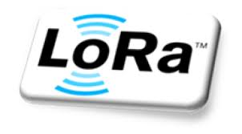
















The iot connectivity soup

Slide 4
networking: “GLUE” for the IOt
(Too) many different approaches, (too) many different standards, (too) much confusion
One size does not fit all: best network depends on application
What are the key organizing principles and ideas?

Slide 5
Architecture, simplified
Servers in the “cloud”
Internet
Mediate & Translate
Gateways
Mobile Gateways (phones, tablets)
“Things” (devices, sensors, actuators)
data
Notes:
Gateways are “edge” devices that translate and mediate between the wireless network of “things” and the Internet

Slide 6
But, in fact, a rich design space
How should gateways and things communicate?
Many answers, many approaches

Slide 7
Can’t we just use the wireless internet?
Cellular and Wi-Fi
Yes, we can…
except when we can’t!

Slide 8
Wireless internet for iot?
Cellular (LTE/4G, 3G, 2G) and Wi-Fi are
+ Widely available
+ High bandwidth (for most purposes), so can support high-rate apps
But, each has two big drawbacks
High power: not suitable for battery-operated scenarios
Cellular: often high cost (esp. per byte if usage-per-thing is low)
Wi-Fi: OK in most buildings, but not for longer range
Wi-Fi: In-building powered things (speakers, washers, refrigerators, …)
Cellular: High-valued powered things (e.g., “connected car”)

Slide 9
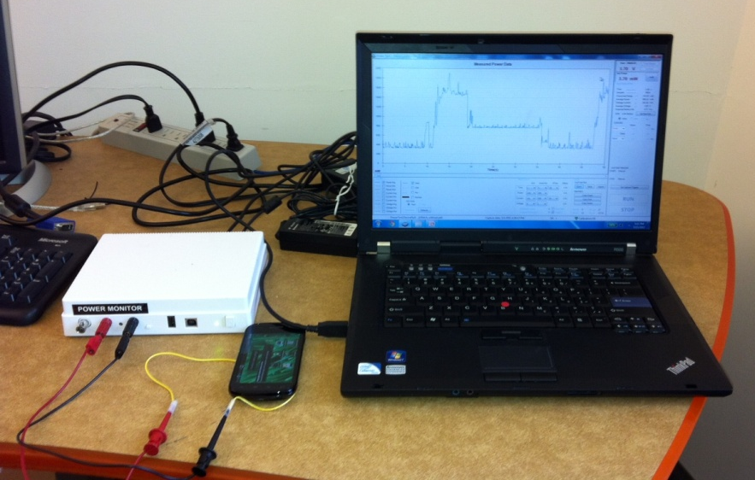
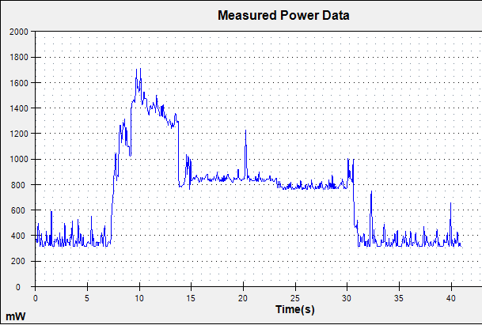
Cellular power consumption
DATA
High-power IDLE
Power monitor apparatus
IDLE
IDLE
Deng & Balakrishnan, “Traffic-Aware Techniques to Reduce 3G/LTE Energy Consumption,” CoNext 2012.

Slide 10
Iot network design space
Device’s data rate (“duty cycle”)
Gbytes per day
Wi-Fi: hours, Gbytes/day, factory
LTE: hours--, Gbytes/day, miles
powered
20 years
bytes per day
hours
inches
Battery life (low-power operation)
body/room
building
factory/campus
miles
Device-to-gateway range

Slide 11
Why so many iot networks?
Because engineers love inventing technologies!
But really because you can pick many interesting regions from this design space
Device’s data rate (“duty cycle”)
10s of Mbits/s
bytes per day
hours
20 years
inches
Battery life (low-power operation)
body/room
building
factory/campus
miles
Device-to-gateway range

Slide 12
Why so many iot networks?
Because engineers love inventing technologies!
But really because you can pick many interesting regions from this design space
Note, axes aren’t independent
And technology evolves fast
Device’s data rate (“duty cycle”)
10s of Mbits/s
bytes per day
hours
20 years
inches
Battery life (low-power operation)
body/room
building
factory/campus
miles
Device-to-gateway range

Slide 13
Why so many iot networks?
Because engineers love inventing technologies!
But really because you can pick many interesting regions from this design space
Note, axes aren’t independent
And technology evolves fast
And bundling into popular devices speeds-up adoption, changing the economics
Cf. Wi-Fi → laptops (without external cards)
Bluetooth classic → cell phones → wireless headsets
Bluetooth Low Energy (BLE) → iPhone then Android smartphones → “body/room” with months-to-years at low duty cycles
Device’s data rate (“duty cycle”)
10s of Mbits/s
bytes per day
hours
20 years
inches
Battery life (low-power operation)
building
body/room
factory/campus
miles
Device-to-gateway range

Slide 14

BODY/Room-AREA example: BlE
Device’s data rate (“duty cycle”)
peak: ~100s of kbits/s
Months-to-years if ~100s kbytes per day
Started as “Wibree” by Nokia (2006)
Dominant technology today
Because of smartphones
Smartphones as gateways
Wearables, fitness trackers Vehicles (bikes, cars)
Battery life (low-power operation)
body/room 10 meters typical 50 meters under good conditions with high TX Longer range might not always be good
Device-to-gateway range

Slide 15
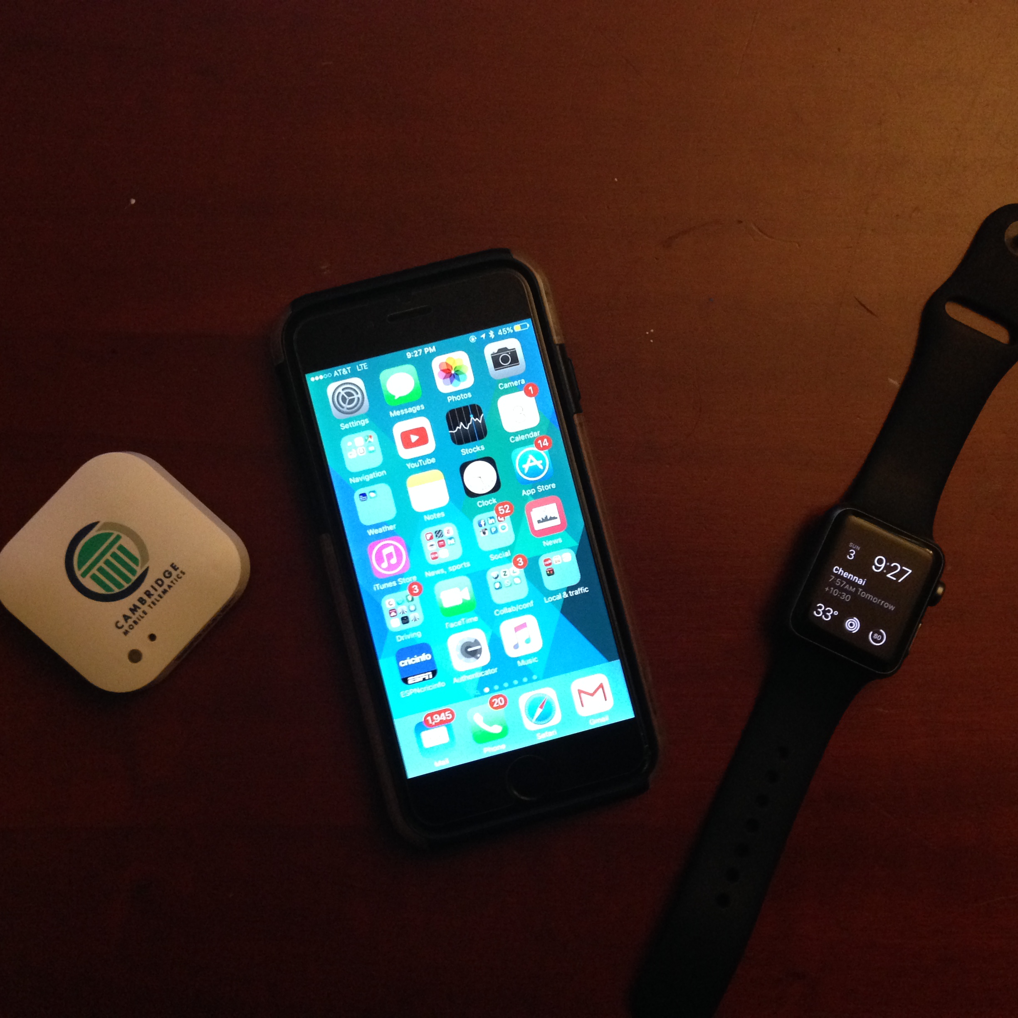
How does ble work?
Two parts:
Advertisements (aka “beaconing”) for device discovery
Connection phase to exchange data
CENTRAL
Peripheral: device with data
Central: gateway
PERIPHERAL
PERIPHERAL

Slide 16
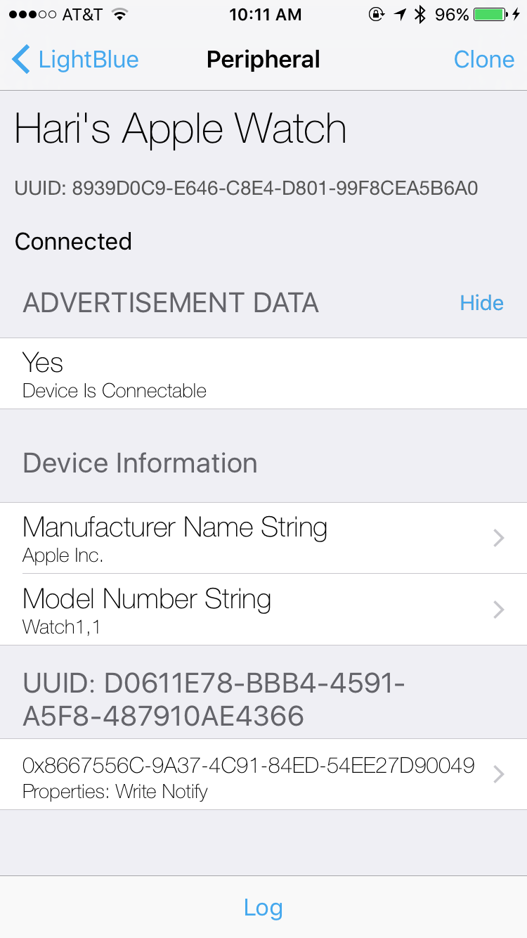
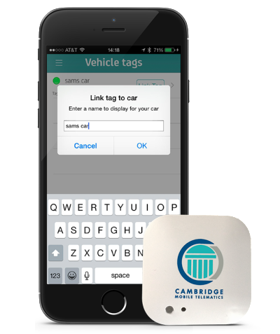
BLE Advertisements are periodic
Typical period: 100 ms (“iBeacon”)
Less frequent is fine
Triggered advertisements are often a good idea
Trade-off between energy consumed and discovery latency

Slide 17
On connection
DEVICE (PERIPHERAL)
SERVICE 1
SERVICE 2
SERVICE 3
READABLE
READ/WRITE NOTIFICATIONS
Usually support
OTA (over-the-air upgrades)
CHARACTERISTIC 1a
CHARACTERISTIC 2a
CHARACTERISTIC 3a
CHARACTERISTIC 1b
CHARACTERISTIC 2b
CHARACTERISTIC 2c

Slide 18
ON CONNECTION: MAC PROTOCOL
Central orchestrates data communication
Key idea: time-schedule to reduce energy consumption
On connect: exchange parameters
Frequency hopping sequence
Connection interval, i.e., periodicity of data exchange (T milliseconds)
Every T milliseconds, Central and Peripheral exchange up to 4 packets, alternating turns
Then Peripheral can go back to sleep until next interval

Slide 19
Battery lifetime calculation
Consider an IoT system with coin-cell battery-powered nodes
Battery: 250 mAh (milliamp-hours) capacity; 3 Volts
Recall that power = voltage * current and energy = power * time
So this battery has 0.75 amp-hour-volts = 0.75*3600 Joules = 2.7 kJ of energy
Example of BLE current draw:
Standby: 1 microAmp (typically in the 1-10 microAmp range)
Receive (RX): 3.3 mA
Transmit (TX): 4 mA
Suppose device transmits every second: how long does the battery last?

Slide 20
Battery calculation (CONT.)
Consider an IoT system with coin-cell battery-powered nodes
Battery: 250 mAh (milliamp-hours) capacity; 3 Volts
Recall that power = voltage * current and energy = power * time
So this battery has 0.75 amp-hour-volts = 0.75*3600 Joules = 2.7 kJ of energy
Example of BLE current draw:
Standby: 1 microAmp (typically in the 1-10 microAmp range)
Receive (RX): 3.3 mA
Transmit (TX): 4 mA
Suppose device transmits every second: how long does the battery last?
4 mA for 1 millisecond
Why 1 millisecond?
125 bytes @1 Mbit/s
1 microAmp

Slide 21
Battery calculation (Cont.)
4 milliAmp for 1 millisecond
Why 1 millisecond?
125 bytes @1 Mbit/s
Ramp-up and down: 1 milliAmp for 5 milliseconds
Over a 1 second interval, average current is:
4 microAmps (xmit) + 5 microAmps (ramping) + 1 microAmp (standby)
= 10 microAmps
Therefore, battery lifetime
= 250 mAh / 10 microAmps
= 250 mAh / 0.01 mA
= 25,000 hours
= 2 years and 10 months
This works because it’s sleeping most of the time!
1 microAmp

Slide 22
IoT “Gateway problem” paper

Slide 23
extending communication range
Device’s data rate (“duty cycle”)
Gbytes per day
bytes per day
20 years
hours
inches
Battery life (low-power operation)
body/room
building
factory/ campus
miles
Device-to-gateway range

Slide 24
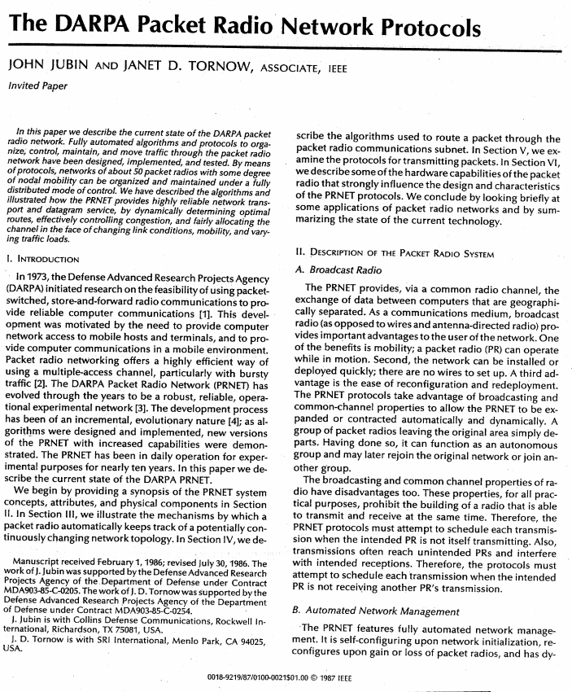
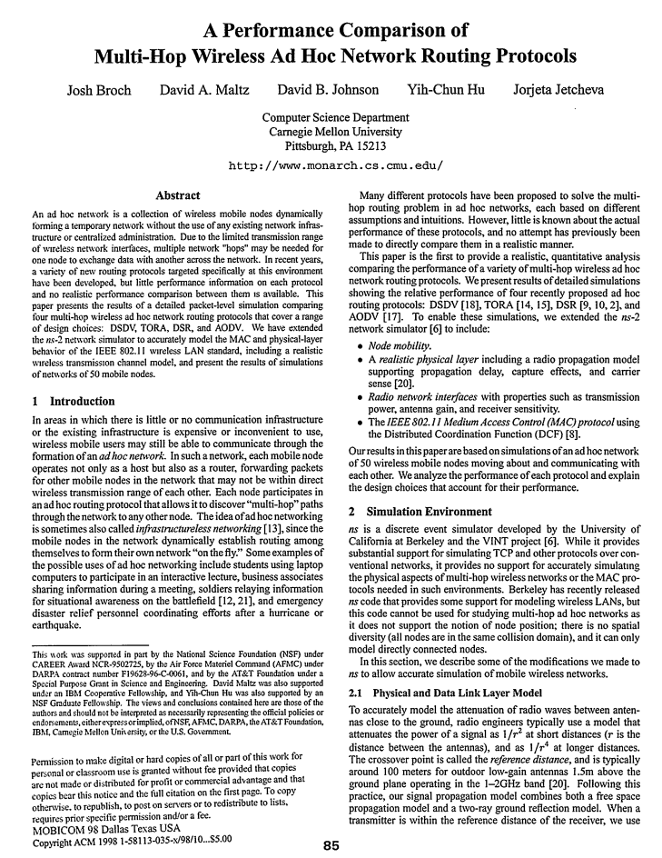
EXTENDING RANGE: MESH NETWORKS
1980s: DARPA packet radio networks
1990s: mobile ad hoc networks (MANET)

Slide 25
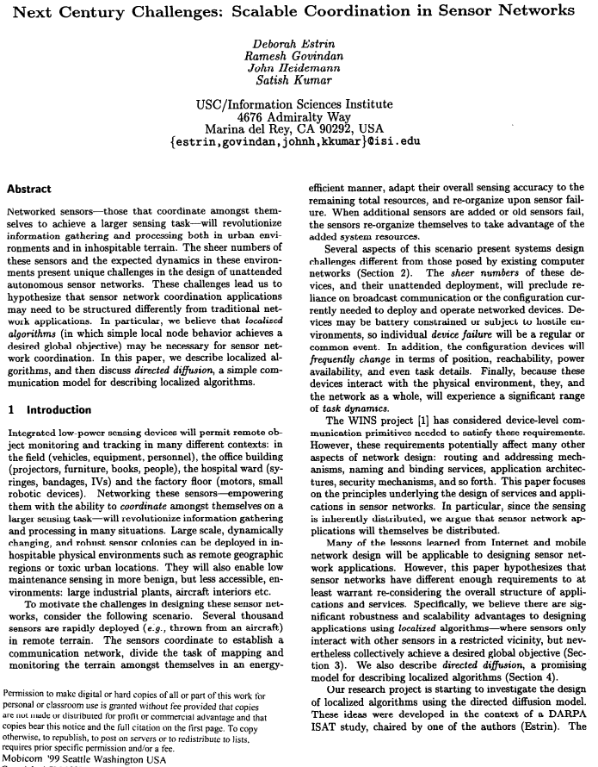
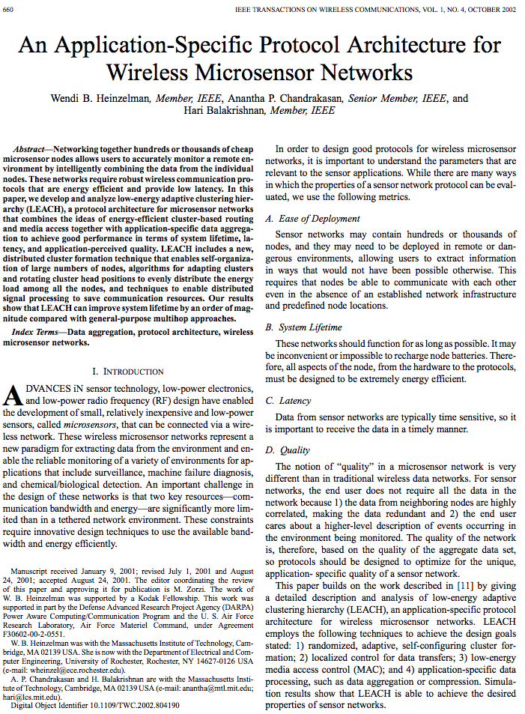
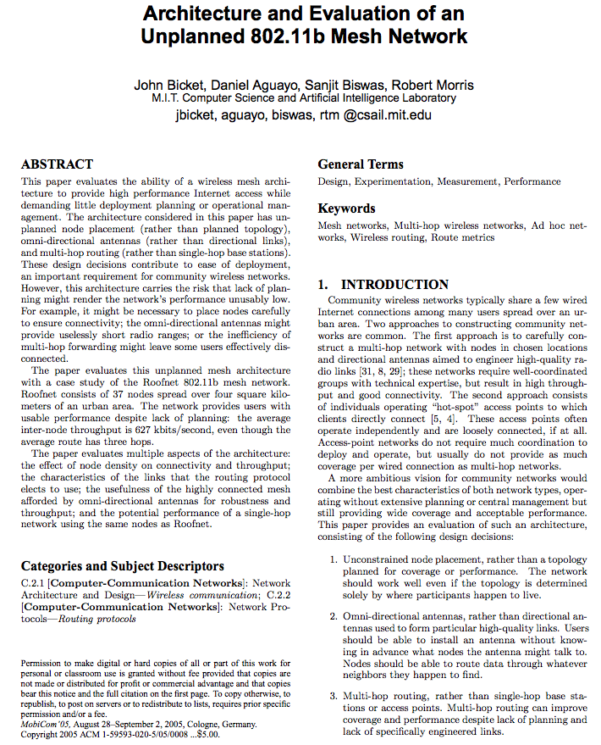
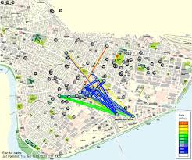
Extending range: mesh networks
Late 90s, 2000s: Sensor networks
2000s: Mesh networks for Internet

Slide 26
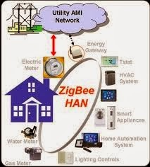
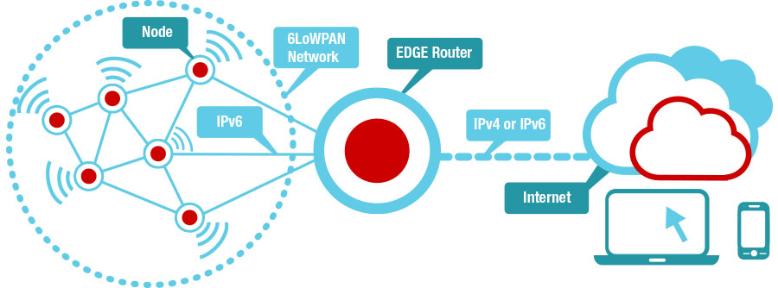
Extending range: mesh networks
2010s: Mesh networks for IoT
6LoWPAN: IPv6 over low-power wireless personal area networks
Zigbee
http://processors.wiki.ti.com/index.php/Contiki-6LOWPAN (Creative commons)
Both (typically) run over the 802.15.4 MAC standard
Routing protocol with different metrics, such as “expected transmission time”
Use case: devices communicating with gateway across multiple hops
Node duty cycles higher, some nodes do much more work

Slide 27
Wireless Mesh routing
Each link delivers a packet with some probability
What path should be used for a packet?
Gateway
Gateway
ETX: Expected Transmission Count
(expected tx time if link rate fixed)
On single link = 1 / Probability of packet delivery
Add for each link on path and pick smallest
100%
50%
75%
75%
100%
100%
75%

Slide 28
Even longer range (city-scale)
Device’s data rate (“duty cycle”)
Gbytes per day
bytes per day
20 years
hours
inches
Battery life (low-power operation)
body/room
building
factory/ campus
miles
Device-to-gateway range

Slide 29
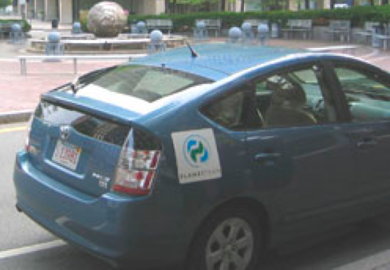
When the internet is miles away
Use mobile devices
as data mules
Trade-off: delay
Delay-tolerant network (DTN)

Slide 30
What if we want long range and low delay?
“Long-range IoT networks”
Examples: Sigfox, LoRaWAN, cellular IoT proposals (narrowband LTE, etc.)
Low-power designs (months to years of battery life)
Low or ultra-low throughput (a few bytes per day to achieve long-enough battery life at a rate of a few kbps)
Networks like LoRaWAN also include localization capabilities

Slide 31
What if we want long range and low delay
Second choice: Cellular (of course!)
Examples: LTE/4G, 3G, etc.
High-power consumption, so only when power isn’t an issue
Delay still a concern for data-intensive, latency-sensitive applications

Slide 32
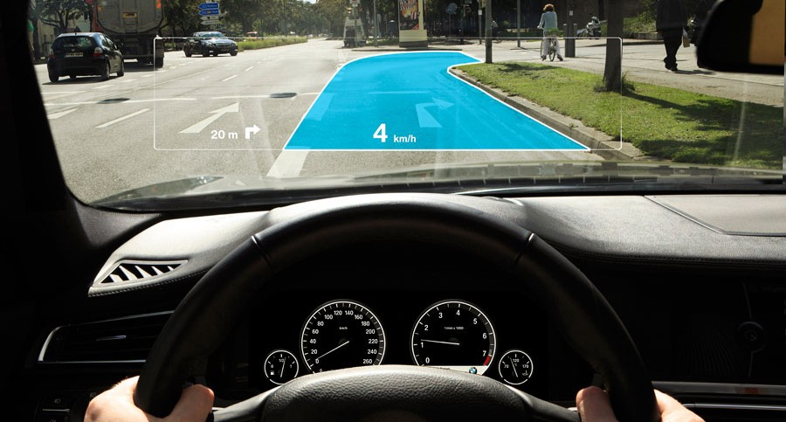
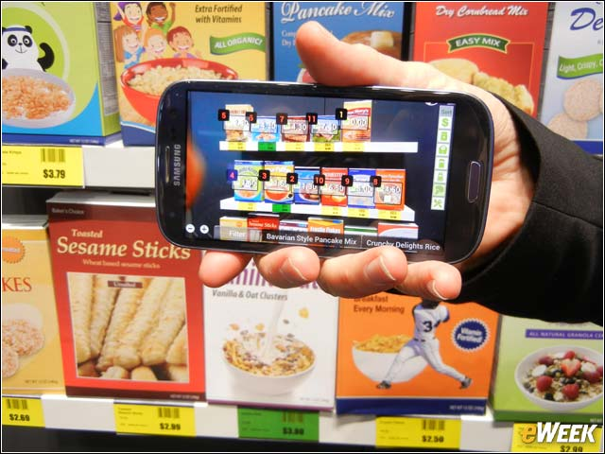
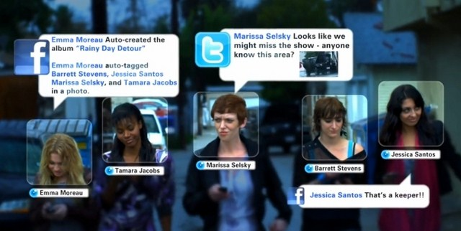
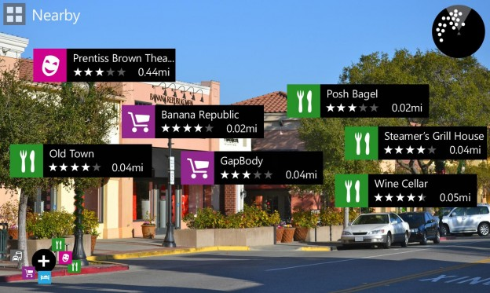
Continuous recognition apps
SLOW
Driver Assistance
Augmented Reality Shopping
Face Recognition
Augmented Reality Tourist App

Slide 33




Glimpse: continuous real-time recognition
Continuous, real-time object recognition on mobile devices in a video stream
Continuously identify and locate objects in each frame
Alice
Alice
Bob
Alice
Bob
Alice
Bob
T. Chen, L. Ravindranath, S. Deng, P. Bahl, H. Balakrishnan, SenSys 2015
The Internet of Things

Slide 34

Recognition pipeline
Detection
Feature Extraction
Classification
Stop Sign
T. Chen, L. Ravindranath, S. Deng, P. Bahl, H. Balakrishnan, SenSys 2015

Slide 35
Recognition pipeline
Detection
Feature Extraction
Classification
Stop Sign
Computationally expensive and memory-intensive
Server is hundreds of times faster than embedded/mobile computer
Scaling to large number of images requires servers

Slide 36
Solution: server offload
Server
Detection
Feature Extraction
Classification
Frame
Network
Labels,
bounding boxes
Client
Camera
Display
Two big challenges
End-to-end latency lowers object recognition accuracy
2. Bandwidth and battery-efficiency

Slide 37





IDEA: Device-side active cache
Cache and run tracking through the cached frames
Server
Network
Active Cache
Frame 0

Slide 38

Server
Alice
Network
Active Cache
Frame 0

Slide 39
Server
Network
Active Cache
Alice
Run tracking from Frame 0 to Frame 30
Frame 0
Frame 30

Slide 40
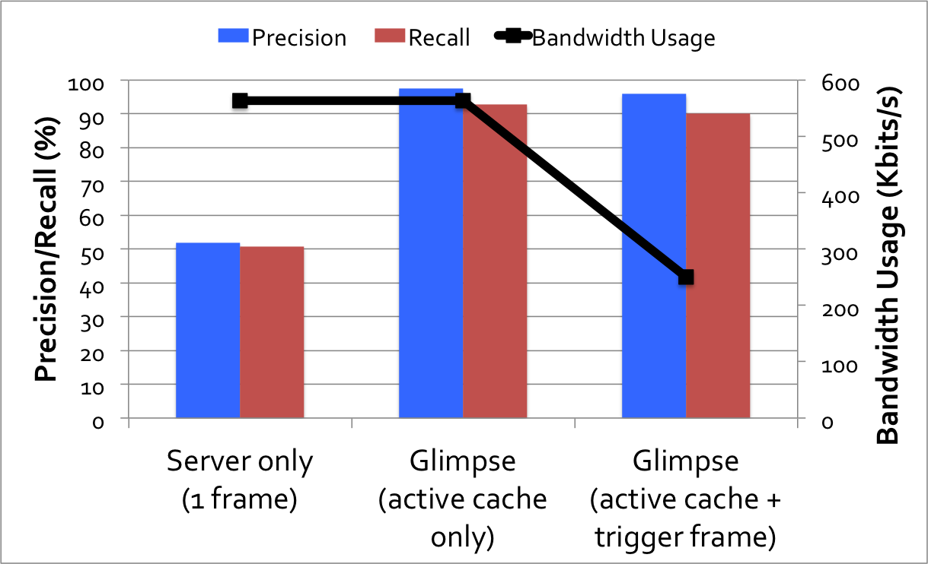
Performance on faces
Average end-to-end frame delay to server and back: 430 ms

Slide 41
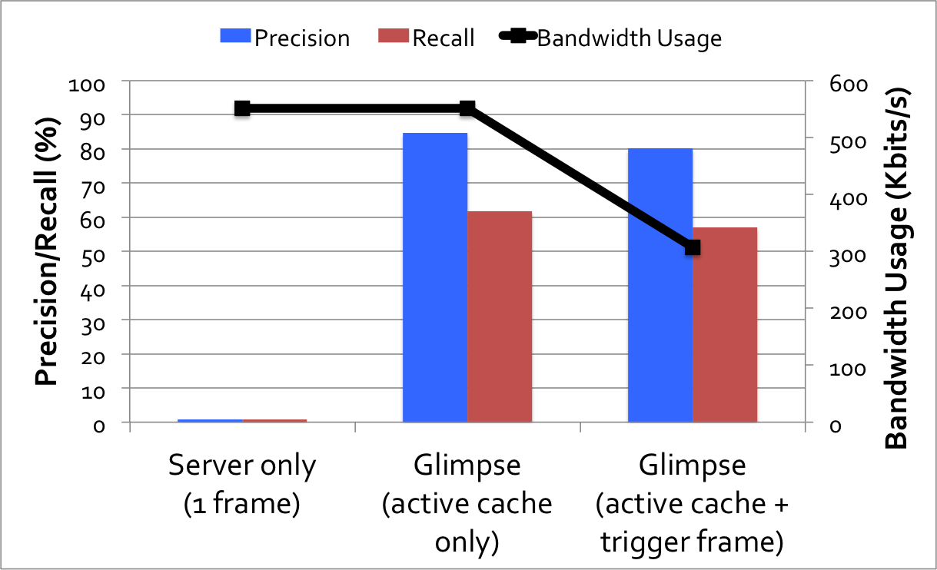
Performance on road signs
Average end-to-end frame delay to server and back: 520 ms

Slide 42
What have we learned?
Rich design space for things-gateway communication
Think along three dimensions:
data rate/duty cycle
battery
range
Three case studies
Low-power design (Bluetooth LE): advertisement, time-scheduled MAC
Range extension techniques: muling & meshing (Zigbee, 6LoWPAN)
Data-intensive IoT: continuous recognition
Servers
Internet
Gateways
Device’s data rate (“duty cycle”)
10s of Mbits/s
bytes per day
hours
20 years
Things
inches
body/room
Battery life (low-power operation)
building
factory/campus
miles
Device-to-gateway range

Slide 43
Open questions and future work
We are not even at the end of the beginning of IoT!
(Who wants to turn on a light bulb by going to an app?!)
What if you want city-scale, high-rate, low-power sensing? (e.g., high-fidelity vibration, weather, image sensors)
Current systems gated by standby power (microWatts)
Recent advances have shown nanoWatt standby power
How will this change IoT networks?
Current IoT apps are “siloed” from each other How to integrate them?

Slide 44
DE-Siloing
Today: build IoT devices/sensors, build an app, build a cloud service
Vertically-integrated: hard to integrate and slows innovation Gateway functions are repeatedly invented
The issue: real value is in the data, not in the devices!
Possible (non-exclusive) approaches
Coordinate access to data via server-side APIs in the cloud
Provide access to data in smartphone apps via “kits” (HomeKit, Healthkit, Google Fit, …)
Develop a generic gateway (multiple technologies)

Slide 45
predictions
Shake-up in standards: multiple winners, but they will divide up the “three-dimensional space”
Ultra-low power IoT systems and networks
Compute-intensive (data-intensive) IoT systems and networks
De-siloed architectures
Smartphone-centric v. hidden (ubiquitous) computing
Notes:
Anticipate changes and innovations in the coming years

